Slide 1
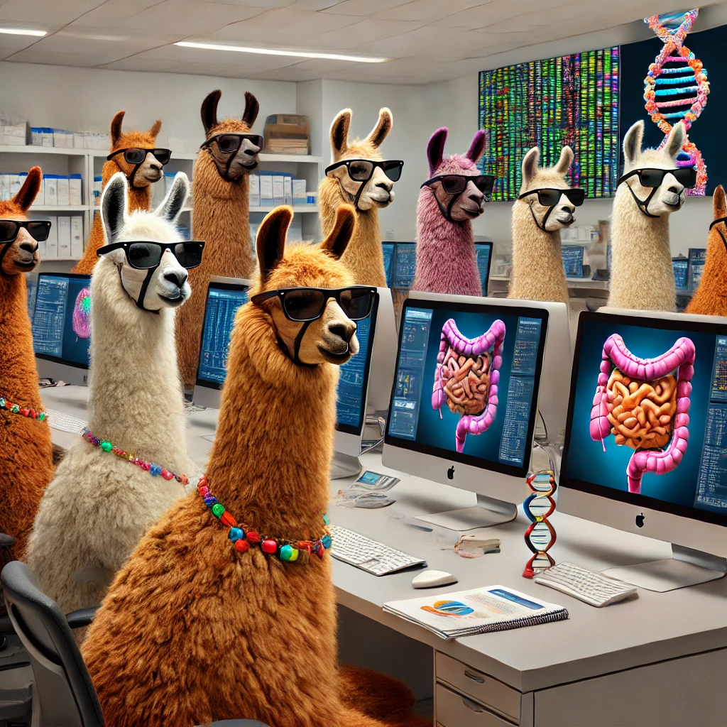
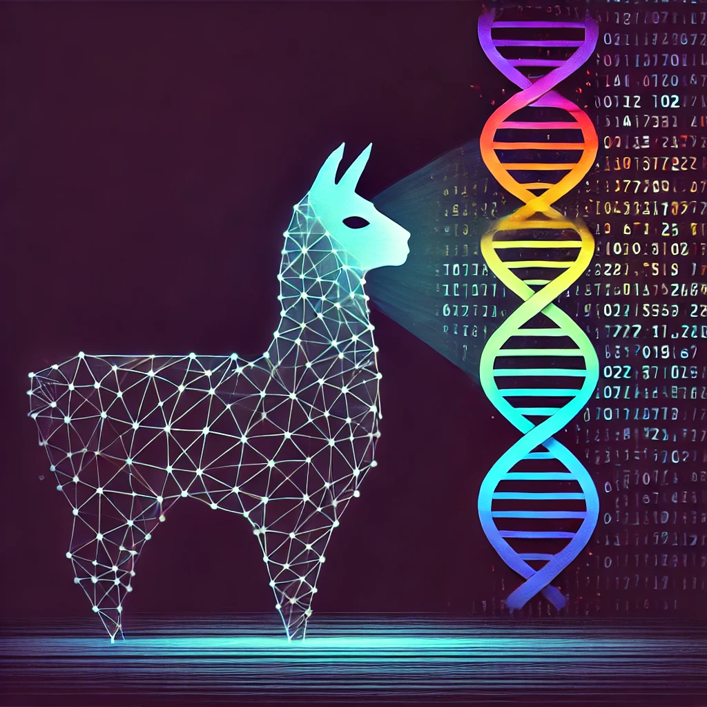
LLM Hackathon: Unlocking Data Using Large Language Models
Alex Kadhim
23 April 2025

Slide 2
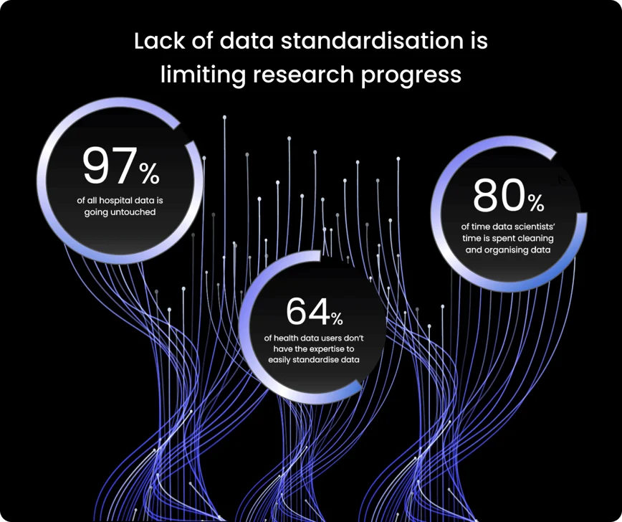

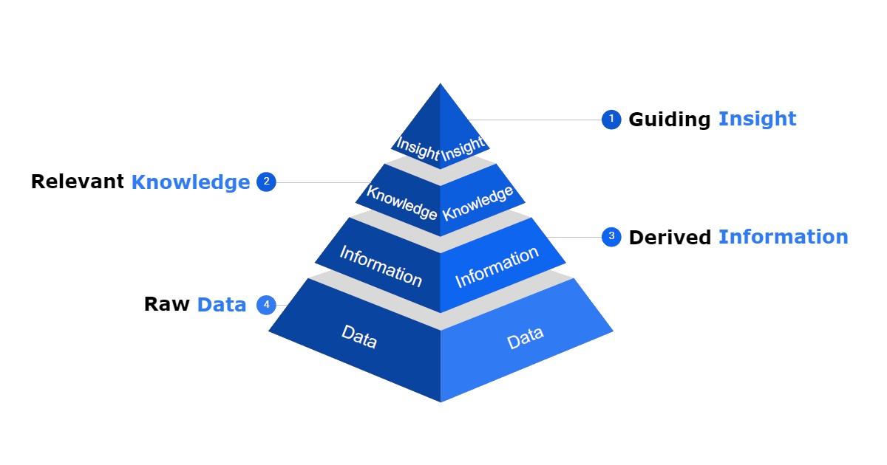
Data quality is very important
Having high quality data in health care research is critical
https://www.lifebit.ai/blog/what-is-health-data-standardisation-and-why-is-it-important

Slide 3








What is standardised data?

Slide 4



Data FAIRification Why do we care?
Not having FAIR data slows research and increases costs
Structuring/standardising data would allow for faster and more research output
Not having FAIR data costs the European economy ~£9-22 billion per year

Slide 5
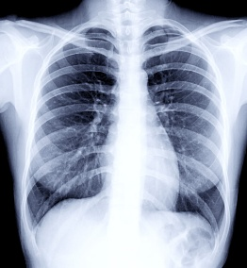
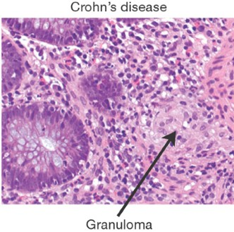
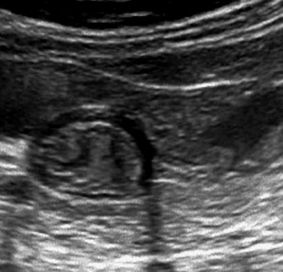
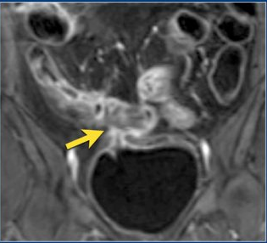

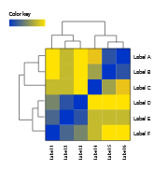


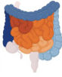
Two bottlenecks
Raw Data → Qualitative Text
Multimodal images:
Xrays, histology slides, MRI, CT, US, etc
Very computationally intensive
2) Text → Structured database
Currently a big bottleneck at this step
1
2

Slide 6
Two bottlenecks
Raw Data → Qualitative Text
Multimodal images:
Xrays, histology slides, MRI, CT, US, etc
Very computationally intensive
2) Text → Structured database
LLMs are good at this step
Can use run open source LLMs to safely run without sending sensitive data out
1
2

Slide 7
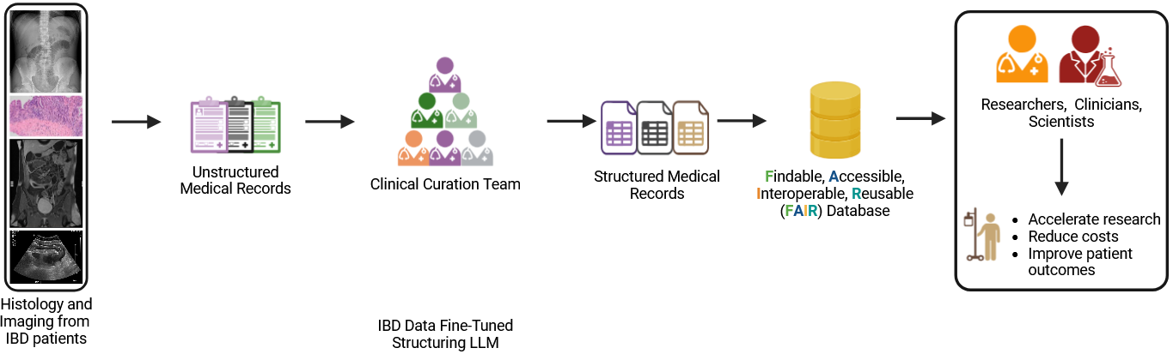

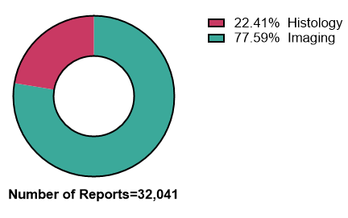
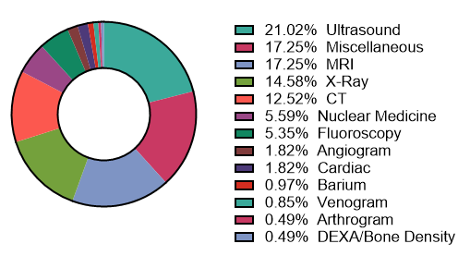
Using large language models (LLMs) to structure medical records
Hospitals produce ~50 petabytes of data, 97% are unused
Rich (research) data are trapped inside (unstructured) electronic patient records medical records
Extracting and structuring these data has enormous value…for research
Notes:
According to a 2019 report from the World Economic Forum, the average hospital produces approximately 50 petabytes of data per year, with 97% of the data going unused

Slide 8
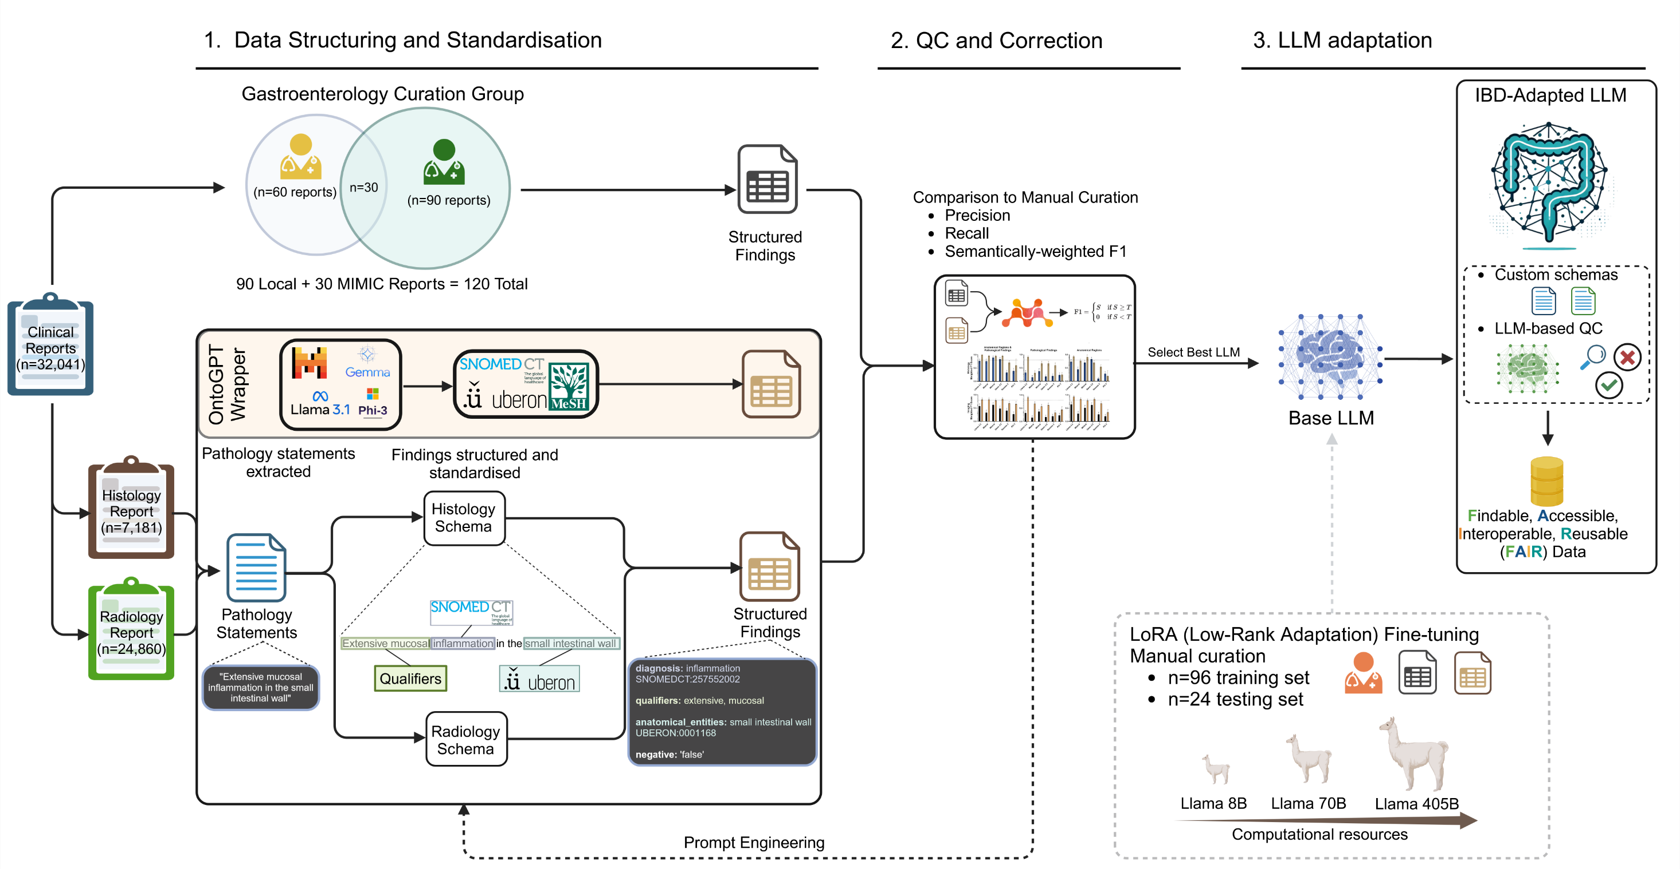

Slide 9

Building a data model
How do we structure and organise this data?

Slide 10
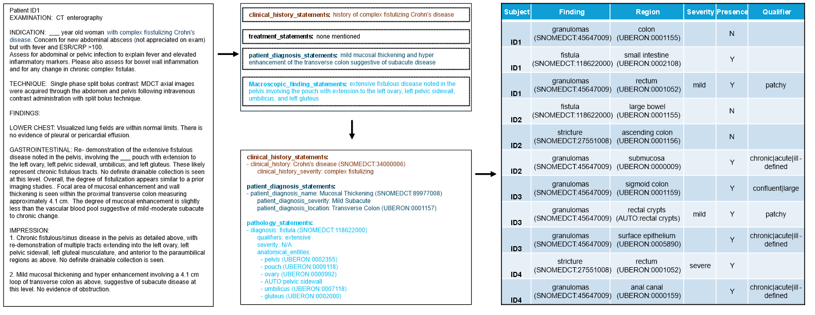
Structuring data is iterative
Report → Statements → Structured Data → Database

Slide 11
Selecting LLMs How to pick which model works best
Closed source LLMs vs Open source
Costs
Patient privacy
How compressed is it?
Llama 3.1 70B Instruct
FP16
Model
Phi3
Mistral
How many parameters it was trained on
8B
70B
405B
What fine-tuning was performed?
Chat
Text
Instruction

Slide 12

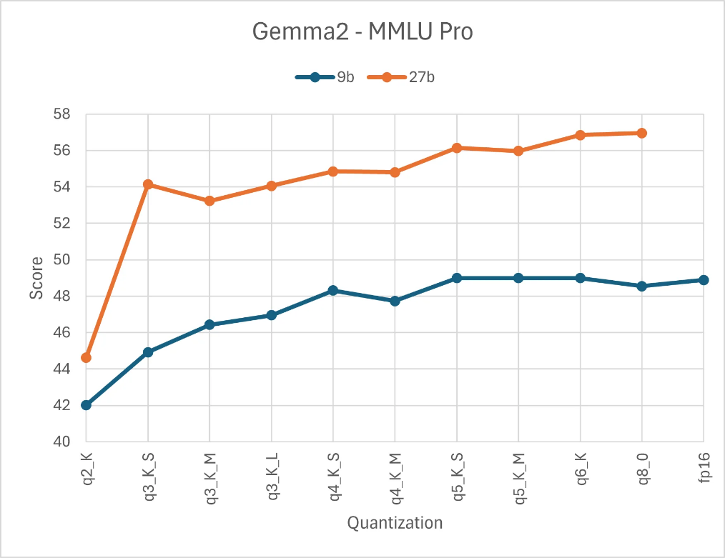
Selecting LLMs Quantisation
LLMs can be computationally heavy
Different levels of quantisation (compression) exist
Sacrifices precision for speed

Slide 13
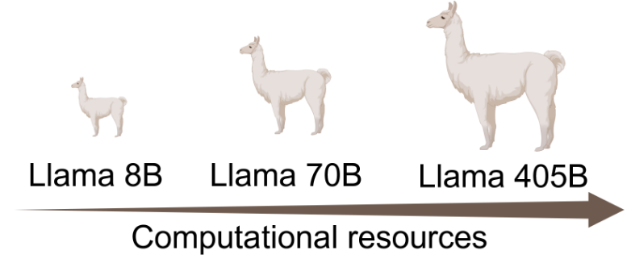
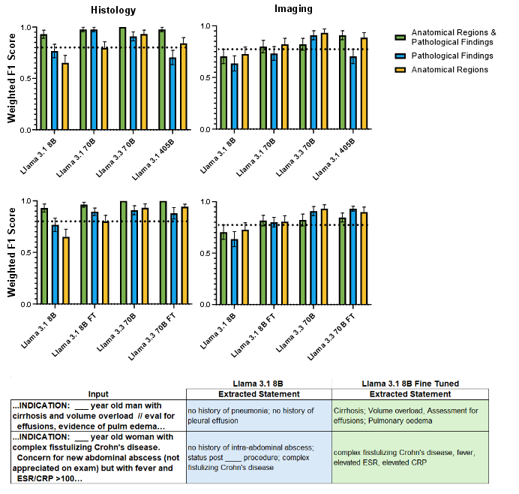
Llama 3.x variations have different computational requirements
Llama 3.1 405B (~800Gb!!!)
Llama 3.1/3.3 70B (~140Gb)
Llama 3.1 8B (~14Gb)

Slide 14

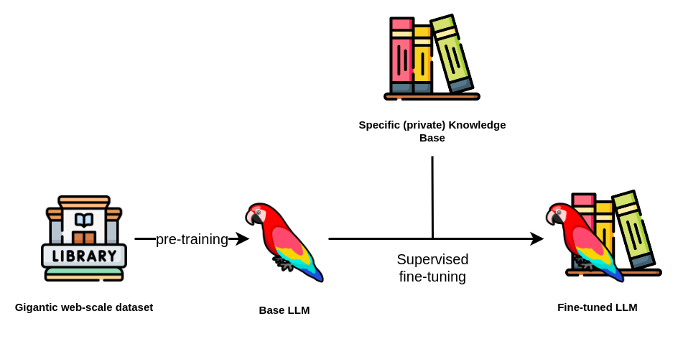
Selecting LLMs Fine tuning models
LLMs can also be fine-tuned to specific tasks
Smaller fine-tuned models can outperform base larger models

Slide 15
Fine tuning a smaller Llama instance can improve performance
Llama 3.3 70B (~140Gb)
Llama 3.1 8B (~14Gb)
Can be further quantised to
smaller size

Slide 16



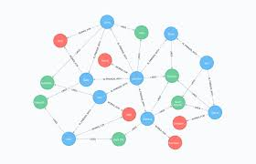




Other use cases for LLMs: Text mining in PubMed/summarising papers
We can use OntoGPT to read papers or medical texts and extract information
Drug → Gene interactions
Protein/Protein interactions
Gene → Human phenotypes
Drug adverse reactions
Much more→ more complex queries!
Title: Clinical, biochemical and genetic characteristics and long-term follow-up of five patients with malonyl-CoA decarboxylase deficiency.
Keywords: Intellectual disability; L-carnitine; MLYCD gene; Malonyl-CoA decarboxylase deficiency; Phenotype
PMID: 39069445
Abstract: Malonyl-CoA decarboxylase (MLYCD) deficiency, also known as malonic aciduria (MAD), is a rare autosomal recessive inherited metabolic defect. In this study, we aimed to investigate the clinical and molecular features of five patients with MAD in order to increase clinicians' awareness of the disease.Sanger sequencing was used to detect and genetically analyze the MLYCD variations in the preexisting patients and their parents.Five patients with MAD (5 months to 9.6 years old; two males and three females) rarely exhibited metabolic decompensation episodes or seizures. All patients exhibited varying degrees of developmental delay and hypotonia. Our study expands the spectrum of variants of the MLYCD gene. MLYCD gene variations were detected in all five patients, and five new variants were identified: c.60delG (p.Arg21Glyfs*52), c.928C > T (p.Arg310*), c.1293G > T (p.Trp431Cys), c.721T > C (p.Ser241Pro), and Exons 4-5 deletion. Additionally, there is no correlation between various genotypes and phenotypes.A high-medium-chain triglyceride and low-long-chain triglyceride diet supplemented with L-carnitine was effective in most patients and may improve cardiomyopathy and muscle weakness. Newborn screening may aid in the early diagnosis, treatment, and prognosis of this rare disorder.Copyright © 2024 The Japanese Society of Child Neurology. Published by Elsevier B.V. All rights reserved.
Gene name

Slide 17
Other use cases for LLMs: Genes to phenotypes
MLYCD → human phenotypes
Title: Clinical, biochemical and genetic characteristics and long-term follow-up of five patients with malonyl-CoA decarboxylase deficiency.
Keywords: Intellectual disability; L-carnitine; MLYCD gene; Malonyl-CoA decarboxylase deficiency; Phenotype
PMID: 39069445
Abstract: Malonyl-CoA decarboxylase (MLYCD) deficiency, also known as malonic aciduria (MAD), is a rare autosomal recessive inherited metabolic defect. In this study, we aimed to investigate the clinical and molecular features of five patients with MAD in order to increase clinicians' awareness of the disease.Sanger sequencing was used to detect and genetically analyze the MLYCD variations in the preexisting patients and their parents.Five patients with MAD (5 months to 9.6 years old; two males and three females) rarely exhibited metabolic decompensation episodes or seizures. All patients exhibited varying degrees of developmental delay and hypotonia. Our study expands the spectrum of variants of the MLYCD gene. MLYCD gene variations were detected in all five patients, and five new variants were identified: c.60delG (p.Arg21Glyfs*52), c.928C > T (p.Arg310*), c.1293G > T (p.Trp431Cys), c.721T > C (p.Ser241Pro), and Exons 4-5 deletion. Additionally, there is no correlation between various genotypes and phenotypes.A high-medium-chain triglyceride and low-long-chain triglyceride diet supplemented with L-carnitine was effective in most patients and may improve cardiomyopathy and muscle weakness. Newborn screening may aid in the early diagnosis, treatment, and prognosis of this rare disorder.Copyright © 2024 The Japanese Society of Child Neurology. Published by Elsevier B.V. All rights reserved.
extracted_object:
id: 6afd49fe-b14f-45c4-80f0-454d7fe1235b
label: Malonyl-CoA decarboxylase deficiency (also known as malonic aciduria, MAD)
phenotypes:
- HP:0001249
- HP:0001263
- HP:0001252
- Metabolic decompensation episodes
- HP:0001250
- HP:0001638
- HP:0001324
named_entities:
- id: HP:0001249
label: Intellectual disability
- id: HP:0001263
label: Developmental delay
- id: HP:0001252
label: Hypotonia
- id: HP:0001250
label: Seizures
- id: HP:0001638
label: Cardiomyopathy
- id: HP:0001324
label: Muscle weakness

Slide 18

Your tasks:
Walk through first notebook to setup OntoGPT, Ollama, etc and extract/structure a simple abstract and a publication
2) Use this knowledge to structure a folder of clinical records in txt format

Slide 19
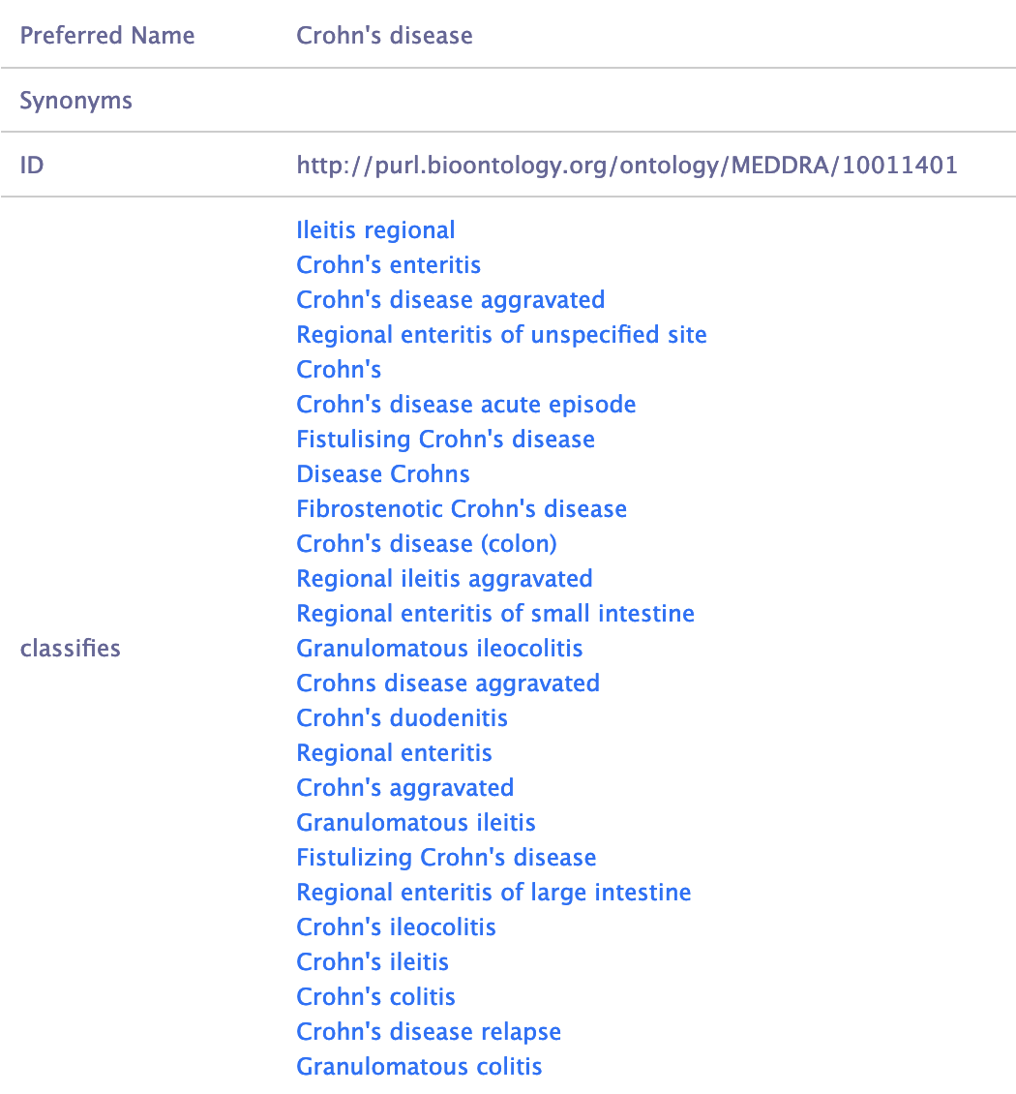
Structuring and harmonising clinical data Using LLMs + NER to structure data
ChatGPT can be used to correct typos and expand shortened words
BioPortal API can be used to match terms to ontologies
Once matched, additional synonyms and classes can be extracted
E.g. →
A combination of ChatGPT and matching to ontologies can be used to maximise data extraction process

